Slide 1
Advanced Database Concept
Yipan Wang
Tzu-an Wang
Yen-hao fan

Slide 2




Slide 3
Task1 : Creating a Procedure and GUI screen for Product Description change ability.
GUI will have two edit box. One for Product ID (Primary Key) and then another edit box for New Description to overwrite old one.
Use these below steps to create a procedure that allows a company employee to make corrections to
a product’s assigned name (Change Product Description). Review the BB_PRODUCT table and identify the PRODUCT NAME and PRIMARY KEY columns. The procedure needs two IN parameters to identify the product ID and supply the new description. This procedure needs to perform only a DML action, so no
OUT parameters are necessary. (Optional : It is best to list Product code name from Drop down list menu and let user choose one product name but find proper Product Code and pass that code as Product Code)

Slide 4
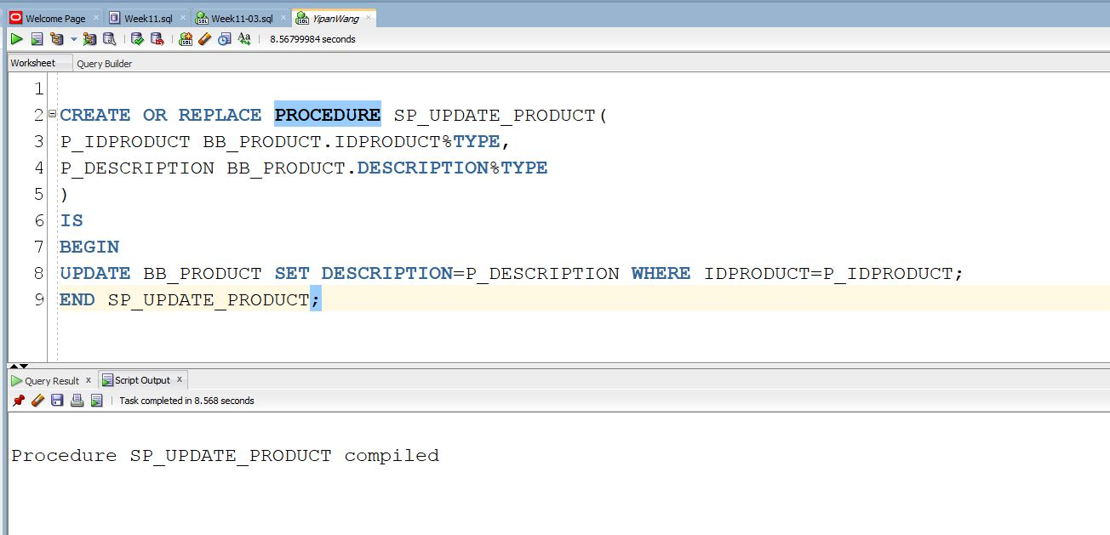
01 sp_update_product

Slide 5
Task 2: Create(Enter) new product by using a Procedure with IN Parameters
Follow these steps to create a procedure that allows a company employee to add a new
product to the database. This procedure needs only IN parameters.
1. In SQL Developer, create a procedure named PROD_ADD_SP that adds a row for a new
product in the BB_PRODUCT table. Keep in mind that the user provides values for the
product name, description, image filename (use same template for file name as ‘roasted.jpg’ or ‘double-roasted.jpg’ ) , price, and active status. Address the input values or parameters in the same order as in the preceding sentence.
2. Call the procedure with these parameter values:
('Roasted Blend', 'Well-balanced mix of roasted beans, a medium body', 'roasted.jpg',9.50,1).
3. Check whether the Insert/Update was successful by querying the BB_PRODUCT table.

Slide 6
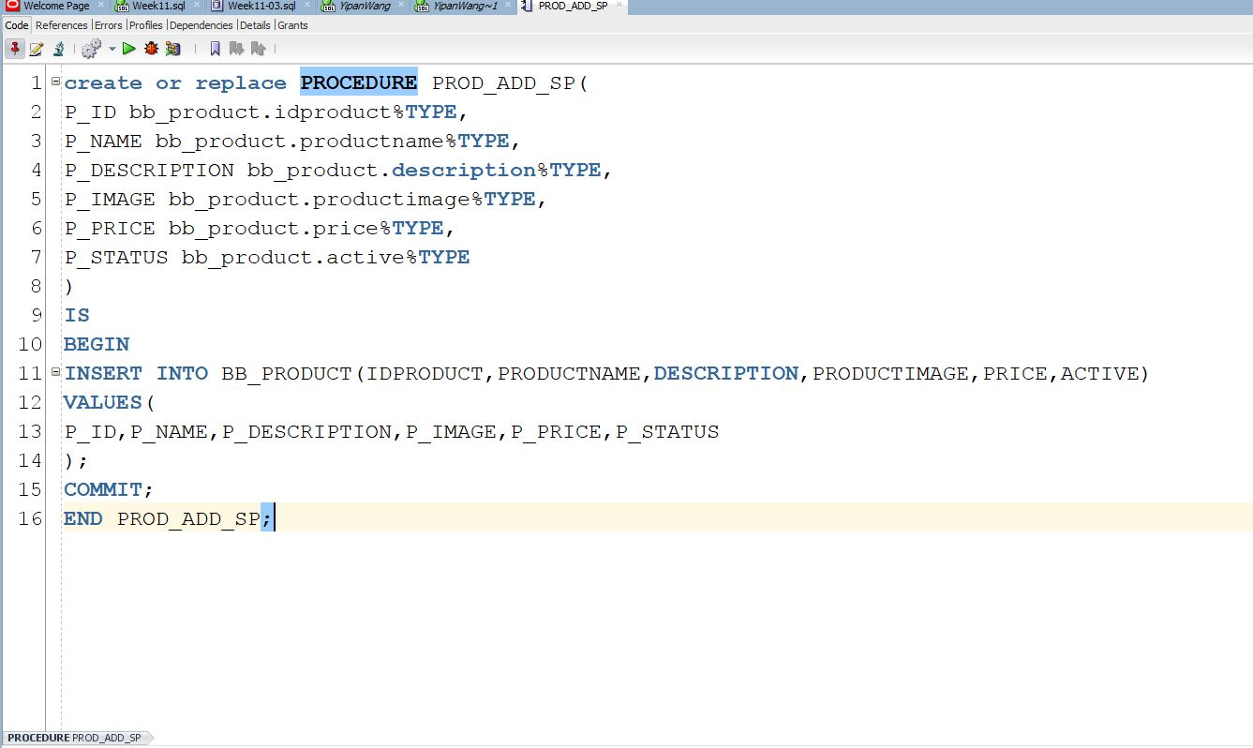
02 PROD_ADD_SP

Slide 7
Task 3: Calculating the Tax on an Order
Follow these steps to create a procedure for calculating the tax on an order. The BB_TAX table
contains states that require submitting taxes for Internet sales. If the state isn’t listed in the
table, no tax should be assessed on the order. The shopper’s state and basket subtotal are the
inputs to the procedure, and the tax amount should be returned.
Make two edit box in your GUI form to accept Shopper’s state and basket subtotal
1. In SQL Developer, create a procedure named TAX_COST_SP. Remember that the state
and subtotal values are inputs to the procedure, which should return the tax amount.
Review the BB_TAX table, which contains the tax rate for each applicable state.

Slide 8
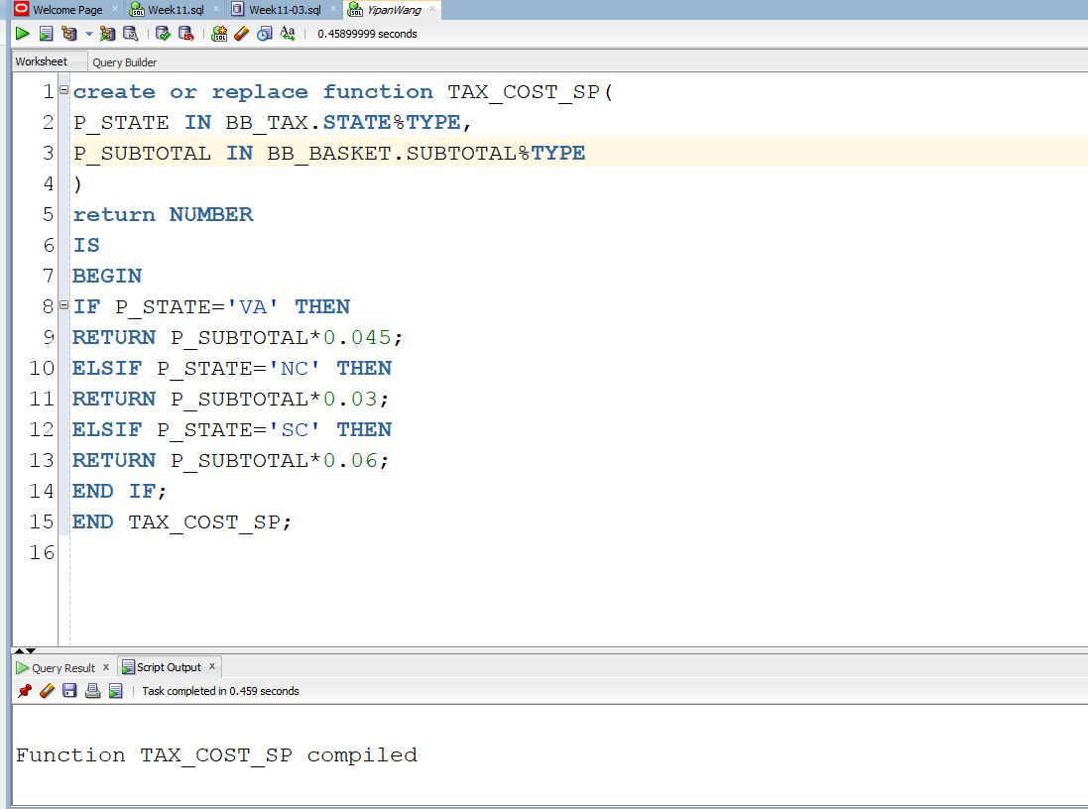
03 tax_cost_sp

Slide 9
Task 4: Updating Order Status
Create a procedure named STATUS_SHIP_SP that allows an employee in the Shipping
Department to update an order status to add shipping information. The BB_BASKETSTATUS
table lists events for each order so that a shopper can see the current status, date, and
comments as each stage of the order process is finished. The IDSTAGE column of the
BB_BASKETSTATUS table identifies each stage; the value 3 in this column indicates that an
order has been shipped.
The procedure should allow adding a row with an IDSTAGE of 3, date shipped, tracking
number, and shipper. The BB_STATUS_SEQ sequence is used to provide an incremental unique auto increment value for the primary key column.

Slide 10
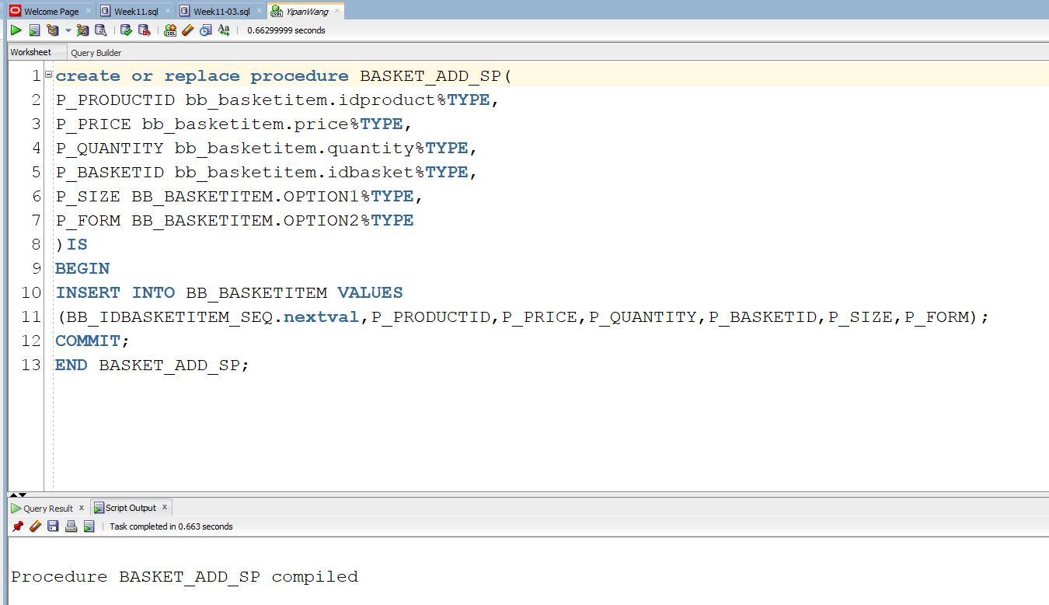
04 BASKET_ADD_SP

Slide 11
Task 5: Adding Items to a Basket
As a shopper selects products on the Brewbean’s site, a procedure is needed to add a newly
selected item to the current shopper’s basket. Create a procedure named BASKET_ADD_SP that
accepts a product ID, basket ID, price, quantity, size code option (1 or 2), and form code option
(3 or 4) and uses this information to add a new item to the BB_BASKETITEM table. The table’s
PRIMARY KEY column is generated by BB_IDBASKETITEM_SEQ.

Slide 12
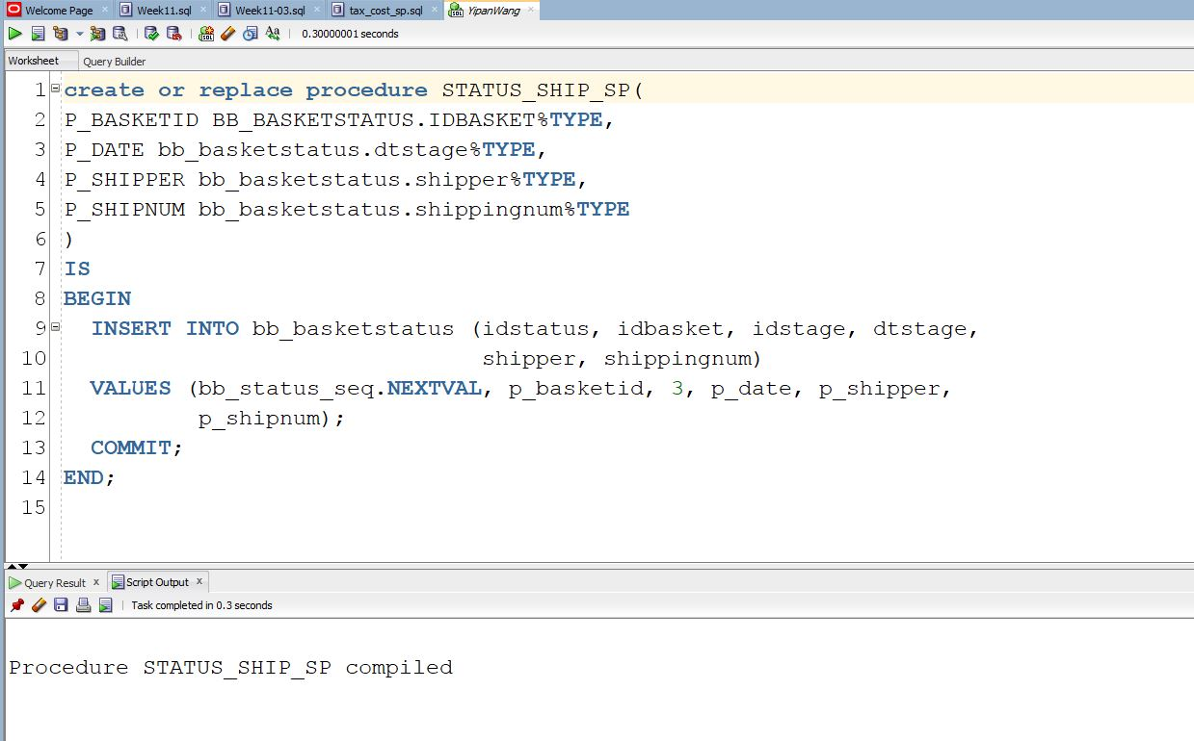
05 STATUS_SHIP_SP

Slide 13
Task 6: Identifying Sale Products
When a product is placed on sale, Brewbean’s records the sale’s start and end dates in
columns of the BB_PRODUCT table. A function is needed to provide sales information when a
shopper selects an item. If a product is on sale, the function should return the value ON SALE!.
However, if it isn’t on sale, the function should return the value Great Deal!. These values are
used on the product display page.

Slide 14
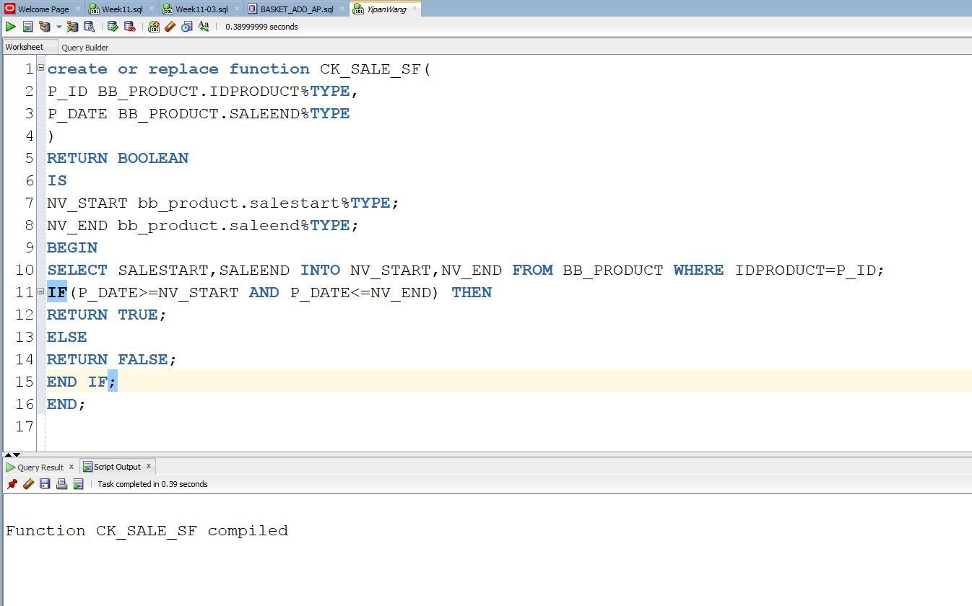
06 CK_SALE_SF

Slide 15
Report 1: Report to show whether all items in her/his basket are in Stock or not? Using an Explicit Cursor
In the Brewbean’s application, a customer can ask to check whether all items in his or her
basket are in stock. In this task, you create a procedure that uses an explicit cursor to
retrieve all items in the basket and determine whether all items are in stock by comparing the
item quantity with the product stock amount.
If all items are in stock, display the message “All items in stock!” onscreen.
If not, display the message “All items NOT in stock!” onscreen.
The basket number will be entered by End User on the screen and then used as INPUT parameter for procedure (Either edit box or make drop down menu item where you bring all basket numbers from database – Up to you) .

Slide 16
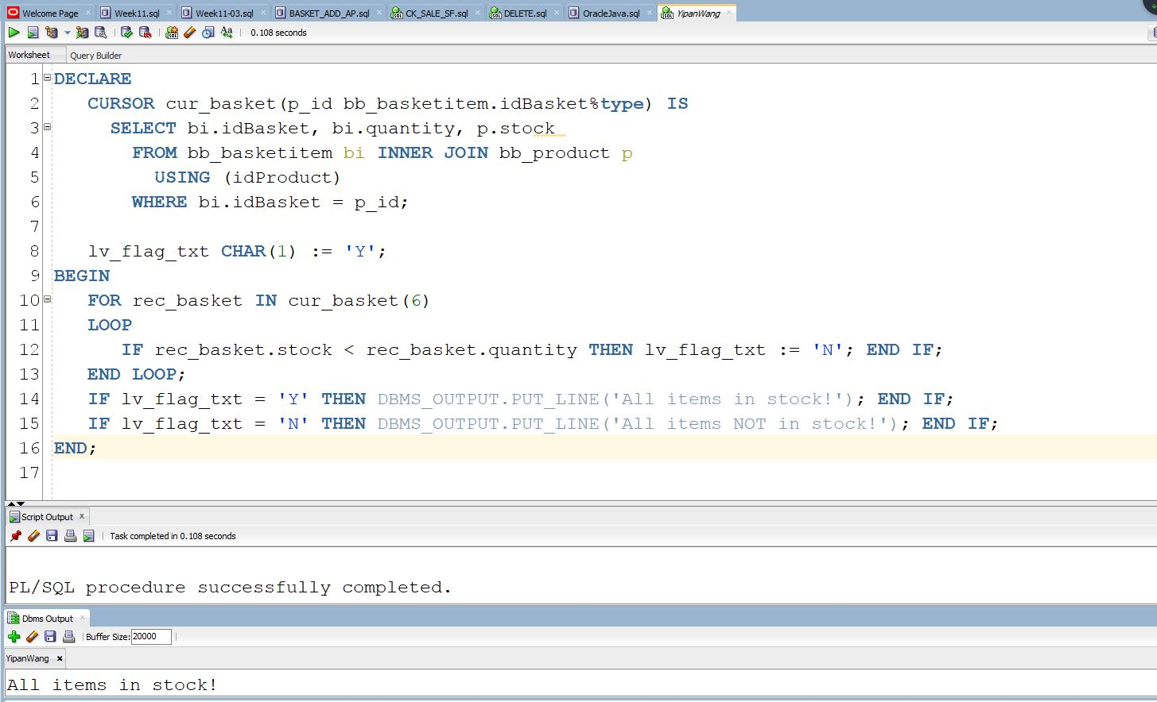
REPORT01

Slide 17
Report 2: Calculating a Shopper’s Total Spending
Many of the reports generated from the system calculate the total dollars in a shopper’s
purchases. Follow these steps to create a function named TOT_PURCH_SF that accepts a
shopper ID as input and returns the total dollars the shopper has spent with Brewbean’s.

Slide 18
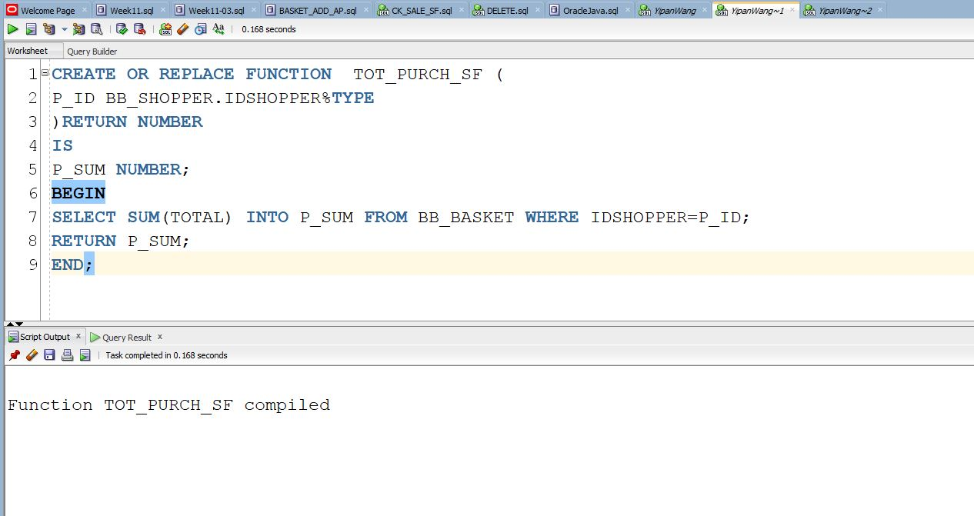
REPORT02

Slide 19
The End

